Slide 1
University case study
Analyzing Institutional and Demographic Factors Influencing College Applications Rates
By: Qin Liu and Marisol Arita

Slide 2
Introduction
A university is currently seeking to improve the number of applications received for their undergraduate program. To accomplish this goal, they conducted a study that collected demographic characteristics and tuition information from 777 universities and colleges across the United States.
We developed a regression model that can identify the key factors correlated with the number of applications received.

Slide 3
Outline:
Data overview
Variables
Methods
Initial model
First residual analysis
Final model
Conclusion

Slide 4
Data Overview
The dataset used is saved in a file named University Data.csv, which contains 19 columns. Below is a description of each column and its meaning.
Apps = Number of applications received(quantitative, integer)
UniversityName= Name of the university (qualitative)
Private = Public/private indicator(qualitative, encoded as binary)
Accept = Number of applicants accepted (quantitative, integer)
Enroll = Number of new students enrolled (quantitative, integer)
Top10perc = New students from top 10 % of high school class (quantitative, integer)
Top25perc = New students from top 25 % of high school class(quantitative, integer)
F.Undergrad = Number of full-time undergraduates(quantitative, integer)
P.Undergrad = Number of part-time undergraduates (quantitative, integer)
Outstate = Out-of-state tuition(quantitative, integer)
Room.Board = Room and board costs
Books = Estimated book costs(quantitative, integer)
Personal = Estimated personal spending (quantitative, integer)
PhD = Percent of faculty with Ph.D.’s (quantitative, integer)
Terminal = Percent of faculty with terminal degree (quantitative, integer)
S.F.Ratio = Student/faculty ratio (quantitative, integer)
perc.alumni = Percent of alumni who donate(quantitative, integer)
Expend = Instructional expenditure per student (quantitative, integer)
Grad.Rate = Graduation rate(quantitative, integer)

Slide 5
Identify dependent and independent variables
We aimed to develop a regression model to identify the key factors correlated with the number of applications received. The dependent variable in this model will be Apps (the number of applications received), while the remaining variables will be considered independent variables. Since the UniversityName column has too many unique levels and adds unnecessary complexity, it will not be included as an independent variable in the model. We also did some data transformation, make the Top10perc, TOP 25perc, PhD, Terminal, perc.alumni, Grad.Rate to the decimal point and give the new name as:
TOP10%, TOP 25%, PHD%, Terminal%, Alum%, Grad Rate% and saved in
University Data_updated.csv

Slide 6

Variable Screening Methods
We employed the All-Possible-Regression Selection Method to evaluate the 17 independent variables. By analyzing metrics such as $R^{2}$, RMSE, $C_{p}$, AIC and BIC, we identified a set of potentially significant predictors and developed the initial model as shown below:
$y=β_{0}+β_{1}x_{1}+β_{2}x_{2}+β_{3}x_{3}+β_{4}x_{4}+β_{5}x_{5}+β_{6}x_{6}+β_{7}x_{7}+β_{8}x_{8}+β_{9}x_{9}+β_{10}x_{10}+β_{11}x_{11}$
$y−Apps$
$x_{1}− \left\{\begin{aligned}1 if private \\ 0 otherwise\end{aligned}\right\} base is not private$
$x_{2}−Accept$
$x_{3}−Enroll$
$x_{4}−Top 10\%$
$x_{5}−top 25\%$
$x_{6}−F.Undergrad$
$x_{7}−Outstate$
$x_{8}− Room.Board$
$x_{9}−PHD \%$
$x_{10}−Expend$
$x_{11}− Grad Rate\%$

Slide 7
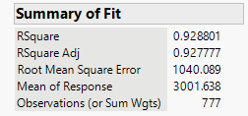
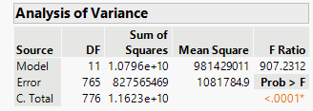
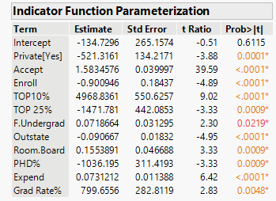
Initial model analysis

Slide 8

Continued:
From the summary of fit result, we can see that model:
F ratio = 907.23, P value < 0.0001
We use the significant level α = 0.05, So P < α,
The model is statistically significant to predict number of applications received
$R^{a}$ is 92.8, so 92.8% variance can be explained by this model.

Slide 9
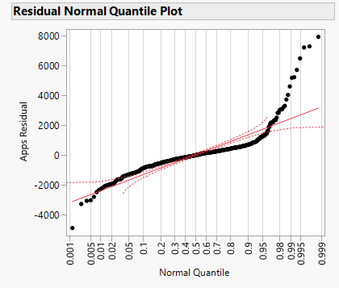
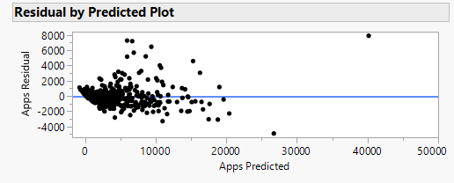
Residual Analysis
Since the model assumes that the random error ε is normally distributed, has a mean of zero, and maintains a constant variance σ2, it is crucial to examine the model's residuals to confirm these assumptions.

Slide 10
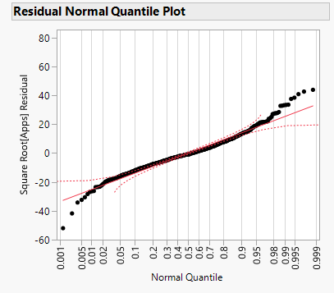

Residual Analysis
We excluded outliers, and used a $\sqrt{y}$ transformation to stabilize the variance.
After the residual looks closer to the line.

Slide 11
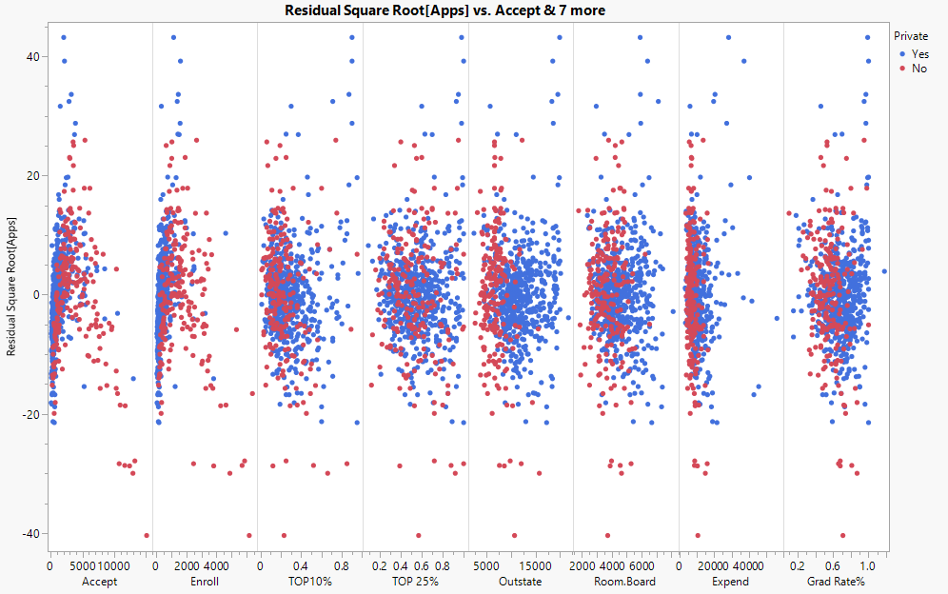
Residual Analysis
Below are the residual vs. independent variable plot, we can see that Accept and Enroll
look has curve pattern, private interfere with the outstate and expend.

Slide 12
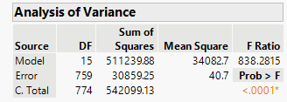
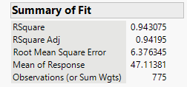
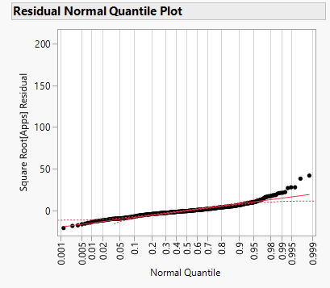
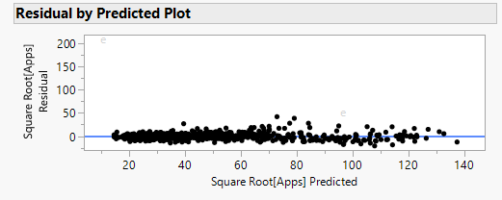
Residual Analysis
We added Accept and Enroll second term and private intersect with outstate and expend. The model improved comparing it with the first term model. The residuals look normal and no obvious pattern detected.

Slide 13

Our final model:
$\sqrt{y}$ = 11.53$−6.1x_{1}+0.02x_{2}+0.003x_{3}+24x_{4}−4.5x_{5}−0.00013x_{6}−0.0002x_{7}+0.001x_{8}−2.28x_{9}+0.0002x_{10}+7.8x_{11}$-0.0000006 ${x_{2}}^{2}−0.0000005{x_{3}}^{2}−0.000065x_{1}x_{7}$+0.0002$x_{1}x_{10}$
$y−Apps$
$x_{1}− \left\{\begin{aligned}1 if private \\ 0 otherwise\end{aligned}\right\} base is not private$
$x_{2}−Accept$
$x_{3}−Enroll$
$x_{4}−Top 10\%$
$x_{5}−top 25\%$
$x_{6}−F.Undergrad$
$x_{7}−Outstate$
$x_{8}− Room.Board$
$x_{9}−PHD \%$
$x_{10}−Expend$
$x_{11}− Grad Rate\%$

Slide 14
Conclusion:
From the model, we can observe that the most influential factors include the following:
Top 10% of High School Class: A higher percentage of students from the top 10% significantly increases the number of college applications.
Graduation Rate: Schools with higher graduation rates tend to attract more applications, indicating its positive impact.
Room and Board Costs: Higher costs for room and board negatively affect the number of applications, likely deterring prospective students.
Faculty with Ph.D.s: Interestingly, a higher percentage of faculty with Ph.D.s appears to decrease the number of applications, which may reflect unique preferences or perceptions among applicants.
These findings highlight key factors that influence application trends and can guide strategies for improving college enrollment.

